Slide 1
Testing Concepts

Slide 2
Agenda
Testing
Verification & Validation
Testing Myths
Quality Assurance & Quality Control
Testing & Debugging
Testing Process Model/Methodology
Testing Approaches
Testing Types
Testing Methods
Testing Levels
Test Automation
Test Assets
Basic Test Principles
Conclusions

Slide 3
What is Testing?
Testing is the process of evaluating a system or its component(s) with the intent to find whether it satisfies the specified requirements or not.
Testing is executing a system in order to identify any gaps, errors, or missing requirements in contrary to the actual requirements.
Testing is a process of execution with an intent to find defects.
Who does Testing ?
- Tester
- Developer
- Project Lead/Manager
- End User

Slide 4
Testing Objectives
Primary Objective:
The purpose of testing is to expose defects primarily through validation and verification.
Verification – Has the right product been built?
Validation – Has the product been built right?
Secondary Objectives:
Instill confidence in the system, through user involvement
Ensure the system will work from both a functional and performance viewpoint
Ensure that the interfaces between systems work
Establish exactly what the system does (and does not do) so that the user does not receive any “surprises"
Identify problem areas where the system deliverables do not meet the agreed to specifications
Improve the development processes that cause errors.

Slide 5
When to start Testing?
An early start to testing reduces the cost and time to rework and produce error-free software that is delivered to the client.
In Software Development Life Cycle (SDLC), testing can be started from the Requirements Gathering phase and continued till the deployment of the software.
It also depends on the development model that is being used. For example in Waterfall model, formal testing is conducted in the testing phase; but in the incremental model, testing is performed at the end of every increment/iteration and the whole application is tested at the end.

Slide 6
When to Stop Testing?
Testing is a never-ending process and no one can claim that a software is 100% tested. The following aspects are to be considered for stopping the testing process:
Testing Deadlines
Completion of test case execution
Completion of functional and code coverage to a certain point
Bug rate falls below a certain level and no high-priority bugs are identified
Management decision

Slide 7
Verification & Validation
Verification | Validation
Verification addresses the concern: “Are you building it right? | Validation addresses the concern: “Are you building the right thing?”
Ensures that the software system meets all the functionality. | Ensures that the functionalities meet the intended behavior.
Verification takes place first and includes the checking for documentation, code, etc. | Validation occurs after verification and mainly involves the checking of the overall product.
Done by developers. | Done by testers.
It has static activities, as it includes reviews, walkthroughs, and inspections to verify a software. | It has dynamic activities, as it includes executing the software against the requirements,
It is an objective process and no subjective decision should be needed to verify a software. | It is a subjective process and involves subjective decisions on how well a software works.

Slide 8
Testing Myths
Myth 1: Testing is Too Expensive
Myth 2: Testing is Time-Consuming
Myth 3: Only Fully Developed Products are Tested
Myth 4: Complete Testing is Possible
Myth 5: A Tested Software is Bug-Free
Myth 6: Missed Defects are due to Testers
Myth 7: Testers are Responsible for Quality of Product
Myth 8: Test Automation should be used Wherever Possible to Reduce Time
Myth 9: Anyone can Test a Software Application
Myth 10: A Tester’s Only Task is to Find Bugs

Slide 9
Quality Assurance
QA includes activities that ensure the implementation of processes, procedures and standards in context to verification of developed software and intended requirements.
Focuses on processes and procedures rather than conducting actual testing on the system.
Process-oriented activities.
Preventive activities.
It is a subset of Software Test Life Cycle (STLC).

Slide 10
Quality Control
It includes activities that ensure the verification of a developed software with respect to documented (or not in some cases) requirements.
Focuses on actual testing by executing the software with an aim to identify bug/defect through implementation of procedures and process.
Product-oriented activities.
It is a corrective process.
QC can be considered as the subset of Quality Assurance.

Slide 11
Testing & Debugging
Testing: It involves identifying bug/error/defect in a software without correcting it. Normally professionals with a quality assurance background are involved in bugs identification. Testing is performed in the testing phase.
Debugging: It involves identifying, isolating, and fixing the problems/bugs. Developers who code the software conduct debugging upon encountering an error in the code. Debugging can be performed in the development phase while conducting Unit Testing or in phases while fixing the reported bugs.

Slide 12
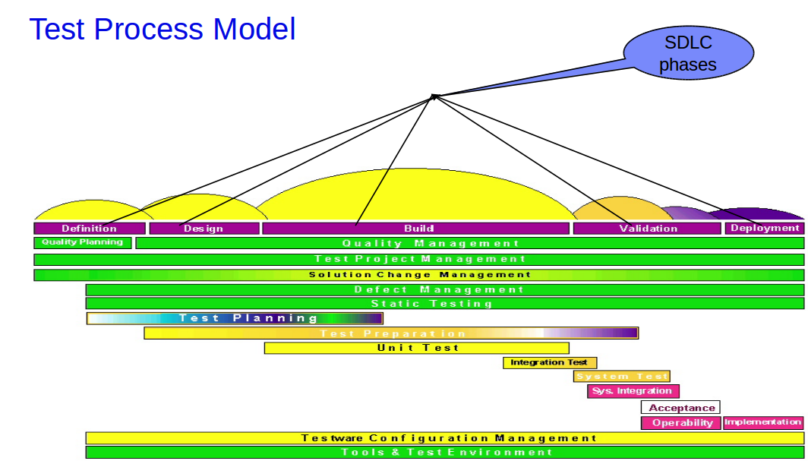
Test Process

Slide 13
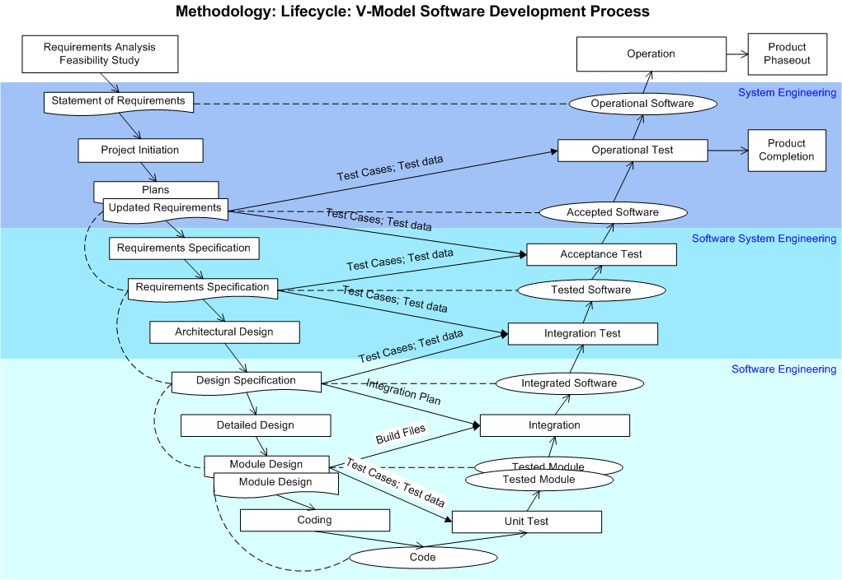

Slide 14
Testing Approaches
Static Testing
Detailed examination of a work product's characteristics to an expected set of attributes, experiences, and standards.
Some static testing techniques are:
Review
Inspection
Walk Through
Examples are:
Plan reviews, Requirements walkthroughs or sign-off reviews, Design or code inspections, Test plan inspections, Test case reviews

Slide 15
Testing Approaches Contd…
Dynamic Testing
Dynamic testing is a process of verification or validation by exercising (or operating) a work product under scrutiny and observing its behavior to changing inputs or environments.
Work product is executed dynamically to test the behavior of its logic and its response to inputs.
Some representative examples of dynamic testing are:
Application prototyping
Executing test cases in a working system
Simulating usage scenarios with real end -users to test usability
Parallel testing in a production environment

Slide 16
Testing Types
Different methodologies can be used while conducting software testing.
The main types of software testing are:
Functional Testing
Non-functional Testing

Slide 17
Functional Testing
The purpose of functional testing is to ensure that the user functional requirements and specifications are met. Test conditions are generated to evaluate the correctness of the application.
This is a type of black-box testing that is based on the specifications of the software that is to be tested.
The application is tested by providing input and then the results are examined that need to conform to the functionality it was intended for.
Functional testing of a software is conducted on a complete, integrated system to evaluate the system's compliance with its specified requirements.

Slide 18
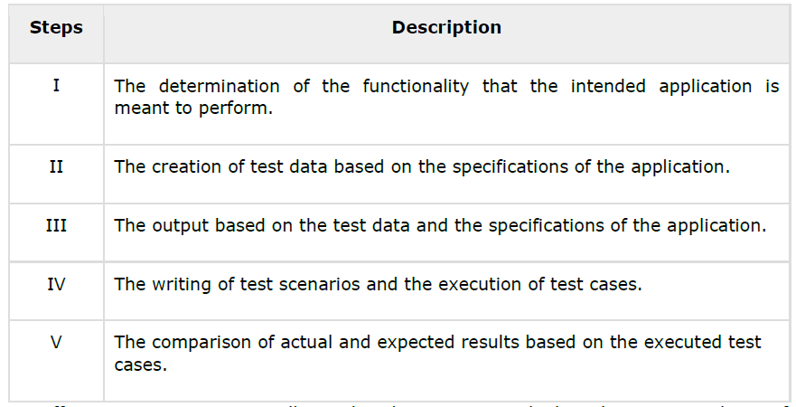
Steps to perform functionality testing:

Slide 19
Non-Functional Testing
Nonfunctional testing involves testing a software from the requirements which are nonfunctional in nature but important such as performance, security, user interface, etc.
Performance Testing
Load Testing
Stress Testing
Usability Testing
UI Testing
Security Testing
Portability Testing

Slide 20
Testing Methods
Black-Box Testing
The technique of testing without having any knowledge of the interior workings of the application is called black-box testing.
The tester is oblivious to the system architecture and does not have access to the source code.
Typically, while performing a black-box test, a tester will interact with the system's user interface by providing inputs and examining outputs without knowing how and where the inputs are worked upon.

Slide 21
Testing Methods
Black-Box Testing Advantages:
Well suited and efficient for large code segments.
Code access is not required.
Clearly separates user's perspective from the developer's perspective through visibly defined roles.
Can test the application with no knowledge of implementation, programming language, or operating systems.

Slide 22
Testing Methods
Black-Box Testing Disadvantages:
Limited coverage, only a selected no of tests are actually performed.
Inefficient testing, tester only has limited knowledge about an application.
Blind coverage, since the tester cannot target specific code segments or error prone areas.
The test cases are difficult to design.

Slide 23
Testing Methods
White-Box Testing:
White-box testing is the detailed investigation of internal logic and structure of the code.
White-box testing is also called glass testing or open-box testing.
In order to perform white-box testing on an application, a tester needs to know the internal workings of the code.
The tester needs to have a look inside the source code and find out which unit/chunk of the code is behaving inappropriately.

Slide 24
Testing Methods
White-Box Testing Advantages:
As the tester has knowledge of the source code, it becomes very easy to find out which type of data can help in testing the application effectively.
It helps in optimizing the code. Extra lines of code can be removed which can bring in hidden defects.
Due to the tester's knowledge about the code, maximum coverage is attained during test scenario writing.

Slide 25
Testing Methods
White-Box Testing Disadvantages:
Due to the fact that a skilled tester is needed to perform white-box testing, the costs are increased.
Sometimes it is impossible to look into every nook and corner to find out hidden errors that may create problems, as many paths will go untested.
It is difficult to maintain white-box testing, as it requires specialized tools like code analyzers and debugging tools.

Slide 26
Testing Methods
Grey-Box Testing:
Grey-box testing is a technique to test the application with having a limited knowledge of the internal workings of an application.
Mastering the domain of a system always gives the tester an edge over someone with limited domain knowledge.
Unlike black-box testing, where the tester only tests the application's user interface; In grey-box testing, the tester has access to design documents and the database. Having this knowledge, a tester can prepare better test data and test scenarios while making a test plan.

Slide 27
Testing Methods
Grey-Box Testing Advantages:
Grey-Box Testing offers combined benefits of black-box and white-box testing wherever possible.
Grey box testers don't rely on the source code; instead they rely on interface definition and functional specifications.
Based on the limited information available, a grey-box tester can design excellent test scenarios especially around communication protocols and data type handling.
The test is done from the point of view of the user and not the designer.

Slide 28
Testing Methods
Grey-Box Testing Disadvantages:
Since the access to source code is not available, the ability to go over the code and test coverage is limited.
The tests can be redundant if the software designer has already run a test case.
Testing every possible input stream is unrealistic because it would take an unreasonable amount of time; therefore, many program paths will go untested.

Slide 29
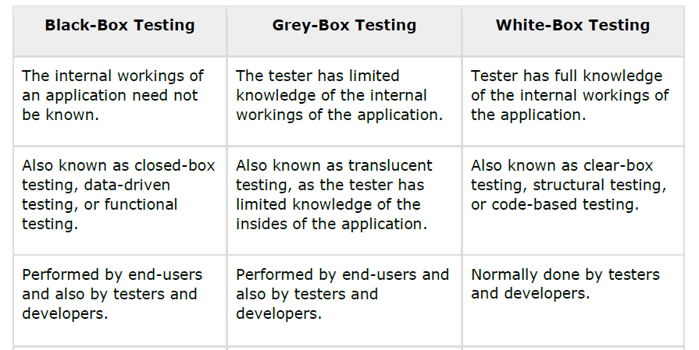
Comparison of Testing Methods

Slide 30
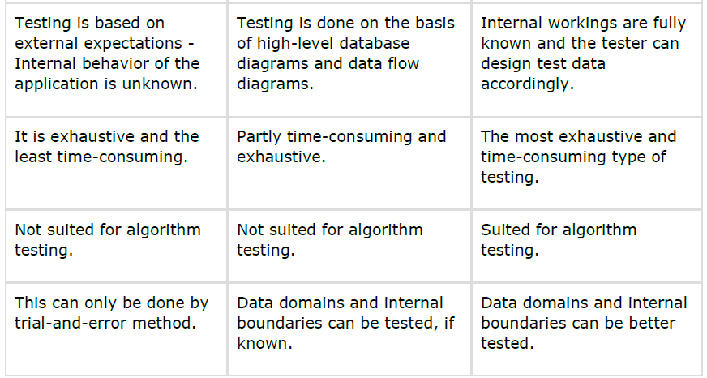
Comparison of Testing Methods

Slide 31
Testing Levels
Depending on phases in SDLC there are different levels of testing such as:
Unit Testing
Integration Testing
System Testing
User Acceptance Testing
Development Phases and Levels of testing:
Coding - Unit Testing, Integration Testing
Testing - Integration Testing, System Testing and User Acceptance Testing

Slide 32
Unit Testing
Unit Testing:
Uses White box testing technique
Verifies the functioning, in isolation, of software pieces that are separately testable. Depending on the context, these could be individual subprograms or a larger component made of tightly related units .
Focuses on the functionally correctness of the individual component’s code
Cost effective testing activity
Usually carried out by the developer
Unit Testing Objectives:
To test the function of a program or unit of code such as a program or module
To test internal logic
To verify internal design
To test path & conditions coverage
To test exception conditions & error handling

Slide 33
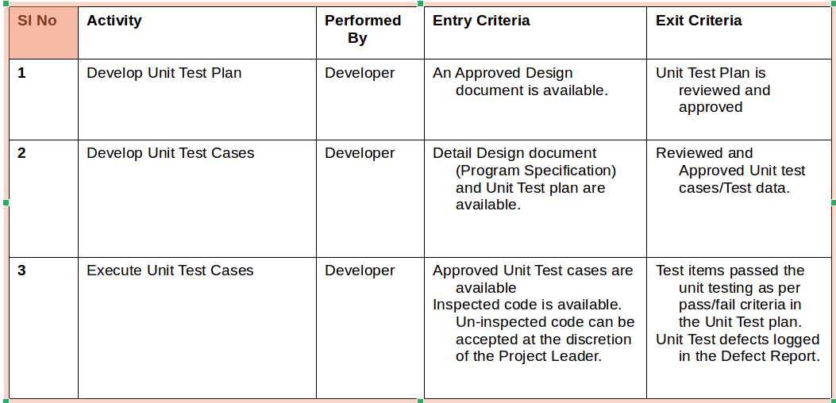
Unit Testing Contd…
Activities, Entry and Exit Criteria

Slide 34
Limitations of Unit Testing
Testing cannot catch each and every bug in an application.
It is impossible to evaluate every execution path in every software application. The same is the case with unit testing.
There is a limit to the number of scenarios and test data that a developer can use to verify a source code.
After having exhausted all the options, there is no choice but to stop unit testing and merge the code segment with other units.

Slide 35
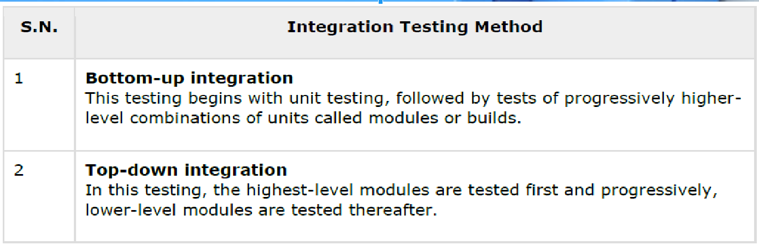
Integration Testing
Integration testing is defined as the testing of combined parts of an application to determine if they function correctly.
Integration level tests verify proper execution of application components and do not require that the application under test interface with other applications. Communication between modules within the subsystem is tested in a controlled and isolated environment within the project.
Integration Testing identifies and resolves problems related to the use of combinations of systems, products and/or solutions that were developed separately but are being used together.
In a comprehensive software development environment, bottom-up testing is usually done first, followed by top-down testing.

Slide 36
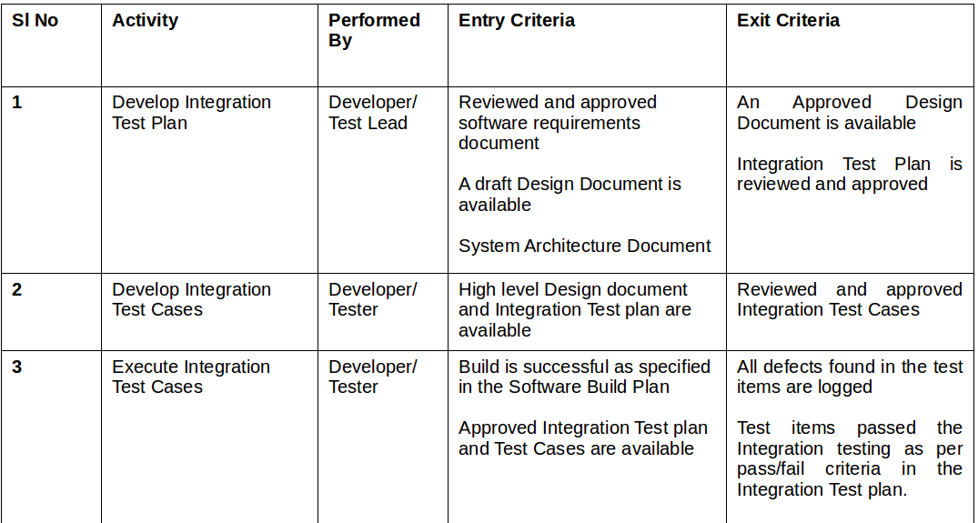
Integration Testing Contd…
Activities, Entry and Exit Criteria

Slide 37
System Testing
System testing tests the system as a whole.
Once all the components are integrated, the application as a whole is tested rigorously to see that it meets the specified Quality Standards.
This type of testing is performed by a specialized testing team.
Uses black box testing technique
Verify proper execution of the entire application components including interfaces to other applications.
Both functional and structural types of tests are performed to verify that the system is functionally and operationally sound.
To verify that the system components perform control functions
To perform inter-system test
To perform appropriate types of tests relating to Transaction Flow, Installation, Reliability, Regression etc.

Slide 38
System Testing Contd…
System testing is important because of the following reasons:
System testing is the first step in the Software Development Life Cycle, where the application is tested as a whole.
The application is tested thoroughly to verify that it meets the functional and technical specifications.
The application is tested in an environment that is very close to the production environment where the application will be deployed.
System testing enables us to test, verify, and validate both the business requirements as well as the application architecture.

Slide 39
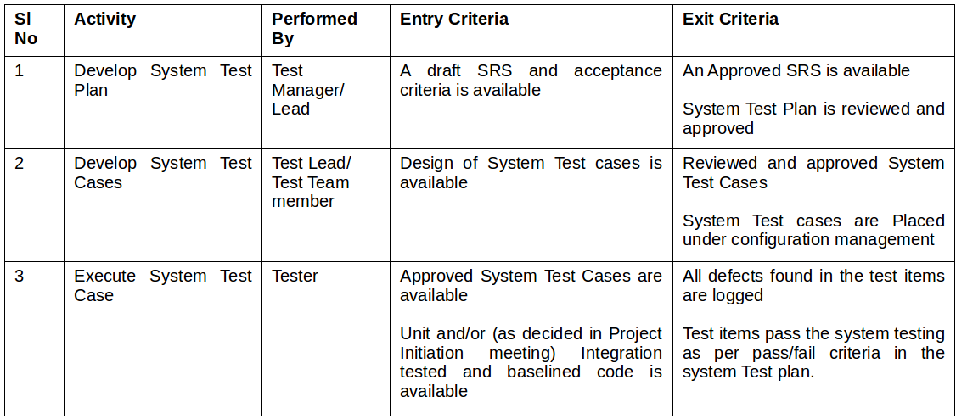
System Testing Contd…
Activities, Entry and Exit Criteria

Slide 40
User Acceptance Testing
Conducted by the Quality Assurance Team to gauge whether the application meets the intended specifications and satisfies the client’s requirement.
The QA team will have a set of prewritten scenarios and test cases that will be used to test the application.
More ideas and more tests can be performed on it to gauge its accuracy and the reasons why the project was initiated.
Acceptance tests are not only intended to point out simple spelling mistakes, cosmetic errors, or interface gaps, but also to point out any bugs in the application that will result in system crashes or major errors in the application.
By performing acceptance tests on an application, the testing team will deduce how the application will perform in production. There are also legal and contractual requirements for acceptance of the system.
Uses black box testing technique
Simulates the user environment and emphasizes security, documentation and regression tests and will demonstrate that the system performs as expected to the sponsor and end-user so that they may accept the system.

Slide 41
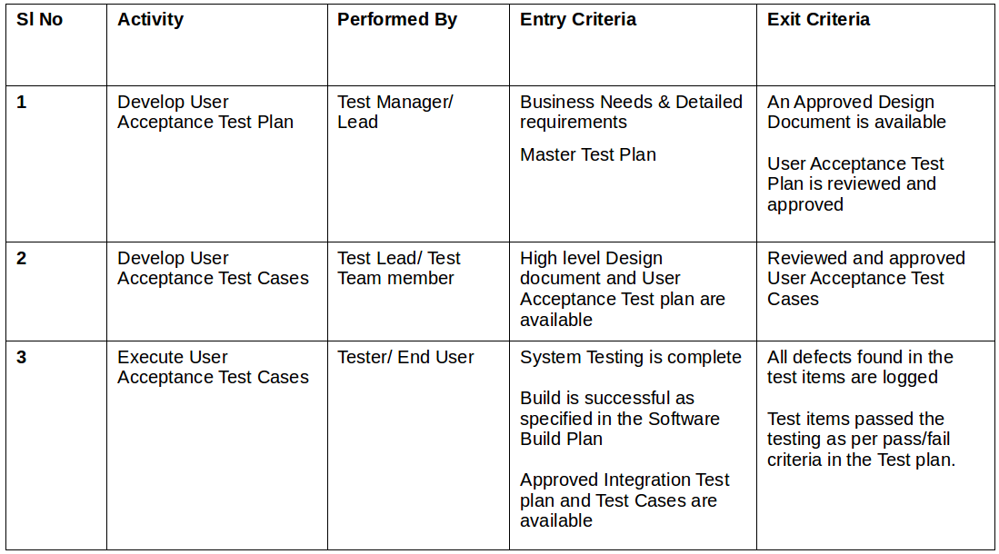
User Acceptance Testing
Activities, Entry and Exit Criteria

Slide 42
Regression Testing
Whenever a change in a software application is made, it is quite possible that other areas within the application have been affected by this change.
Regression testing is performed to verify that a fixed bug hasn't resulted in another functionality or business rule violation.
The intent of regression testing is to ensure that a change, such as a bug fix should not result in another fault being uncovered in the application.
Regression testing is important because of the following reasons:
Minimize the gaps in testing when an application with changes made, has to be tested.
Testing the new changes to verify that the changes made did not affect any other area of the application.
Mitigates risks when regression testing is performed on the application.
Test coverage is increased without compromising timelines.
Increase speed to market the product.

Slide 43
Alpha Testing
This test is the first stage of testing and will be performed amongst the teams (developer and QA teams).
Unit testing, integration testing and system testing when combined together is known as alpha testing.
During this phase, the following aspects will be tested in the application:
Spelling Mistakes
Broken Links
Cloudy Directions
The Application will be tested on machines with the lowest specification to test loading times and any latency problems.

Slide 44
Beta Testing
This test is performed after alpha testing has been successfully performed.
In beta testing, a sample of the intended audience tests the application.
Beta testing is also known as pre-release testing.
Beta test versions of software are ideally distributed to a wide audience on the Web, partly to give the program a "real-world" test and partly to provide a preview of the next release.
In Beta Testing phase, the audience will be testing the following:
Users will install, run the application and send their feedback to the project team.
Typographical errors, confusing application flow, and even crashes.
Getting the feedback, the project team can fix the problems before releasing the software to the actual users.
The more issues you fix that solve real user problems, the higher the quality of your application will be.
Having a higher-quality application when you release it to the general public will increase customer satisfaction.

Slide 45
Performance Testing
Performance Testing is used to identify any bottlenecks or performance issues rather than finding bugs in a software.
There are different causes that contribute in lowering the performance of a software:
Network delay
Client-side processing
Database transaction processing
Load balancing between servers
Data rendering
Performance testing is considered as one of the important and mandatory testing type in terms of the following aspects:
Speed (i.e. Response Time, data rendering and accessing)
Capacity
Stability
Scalability
Performance testing can be either qualitative or quantitative and can be divided into different sub-types such as Load testing and Stress testing.

Slide 46
Load Testing
Process of testing the behavior of a software by applying maximum load in terms of software accessing and manipulating large input data. It can be done at both normal and peak load conditions. This type of testing identifies the maximum capacity of software and its behavior at peak time.
Most of the time, load testing is performed with the help of automated tools such as Load Runner, AppLoader, IBM Rational Performance Tester, Apache JMeter, Silk Performer, Visual Studio Load Test, etc.
Virtual users (VUsers) are defined in the automated testing tool and the script is executed to verify the load testing for the software. The number of users can be increased or decreased concurrently or incrementally based upon the requirements.

Slide 47
Stress Testing
Stress testing includes testing the behavior of a software under abnormal conditions.
The aim of stress testing is to test the software by applying the load to the system and taking over the resources used by the software to identify the breaking point.
This testing can be performed by testing different scenarios such as:
Shutdown or restart of network ports randomly
Turning the database on or off
Running different processes that consume resources such as CPU, memory, server, etc.

Slide 48
Usability Testing
Usability testing is a black-box technique and is used to identify any error(s) and improvements in the software by observing the users through their usage and operation.
Usability is the quality requirement that can be measured as the outcome of interactions with a computer system. The end-user will be satisfied if the intended goals are achieved effectively with the use of proper resources.
According to Nielsen, usability can be defined in terms of five factors, i.e. efficiency of use, learn-ability, memory-ability, errors/safety, and satisfaction.
Molich in 2000 stated that a user-friendly system should fulfill the following five goals, i.e., easy to Learn, easy to remember, efficient to use, satisfactory to use, and easy to understand.

Slide 49
UI Testing
UI testing involves testing the Graphical User Interface of the Software.
UI testing ensures that the GUI functions according to the requirements and tested in terms of color, alignment, size, and other properties.
On the other hand, usability testing ensures a good and user-friendly GUI that can be easily handled. UI testing can be considered as a sub-part of usability testing.

Slide 50
Security Testing
Security testing involves testing a software in order to identify any flaws and gaps from security and vulnerability point of view.
Listed below are the main aspects that security testing should ensure:
Confidentiality
Integrity
Authentication
Availability
Authorization
Non-repudiation
Software is secure against known and unknown vulnerabilities
Software data is secure
Software is according to all security regulations
Input checking and validation
SQL insertion attacks
Injection flaws
Session management issues
Cross-site scripting attacks
Buffer overflows vulnerabilities
Directory traversal attacks

Slide 51
Portability Testing
Portability testing includes testing a software with the aim to ensure its reusability and that it can be moved from another software as well.
Following are the strategies that can be used for portability testing:
Transferring an installed software from one computer to another.
Building executable (.exe) to run the software on different platforms.
Portability testing can be considered as one of the sub-parts of system testing, as this testing type includes overall testing of a software with respect to its usage over different environments.
Computer hardware, operating systems, and browsers are the major focus of portability testing.
Some of the pre-conditions for portability testing are as follows:
Software should be designed and coded, keeping in mind the portability requirements.
Unit testing has been performed on the associated components.
Integration testing has been performed.
Test environment has been established.

Slide 52
Manual Testing
Manual testing includes testing a software manually
Tester takes over the role of an end-user and tests the software to identify any unexpected behavior or bug.
There are different stages for manual testing such as unit testing, integration testing, system testing, and user acceptance testing.
Testers use test plans, test cases, or test scenarios to test a software to ensure the completeness of testing.
Manual testing also includes exploratory testing, as testers explore the software to identify errors in it.

Slide 53
Test Automation
What is automation ?
Test a software using another software.
Process of recording a test and rerunning.
Process of testing with minimum human intervention
It is the use of strategies, tools and artifacts that augment or reduce the need for manual or human involvement or intervention in unskilled, repetitive or redundant tasks.
Why automation ?
Software testing using an automatic test program will generally avoid the errors that humans make when they get tired after multiple repetitions.
The test program won't skip any tests by mistake.
The test program can also record the results of the test accurately.
The results can be automatically fed into a database that may provide useful statistics on how well the software development process is going.

Slide 54
Test Automation
Myths about automation
We will be able to automate all testing!
Test automation will increase productivity so much that we’ll be able to do all the testing with fewer people (eliminate staff).
Test automation is so easy that we won’t need to do any training.
Automation will reduce our whole testing workload.
We won’t need to do any test planning.
Doesn't automation make human testers "obsolete" or "redundant"?
That time-intensive test design effort will no longer be necessary
When to automate?
When there is well defined and stable test requirement
When there is redundant and repetitive and boring tasks which would cause human error
When the focus is on data driven testing to increase coverage
When there is a requirement for virtual entities to relate to real life scenarios
Cost of manual testing is more than automated testing

Slide 55
Test Automation
Test Automation should be used by considering the following aspects of a software:
Large and critical projects
Projects that require testing the same areas frequently
Requirements not changing frequently
Accessing the application for load and performance with many virtual users
Stable software with respect to manual testing
Availability of time
Target specific areas of the total effort as candidates for automation.
Start with highly redundant tasks or scenarios.
Automate repetitive tasks that are boring or tend to cause human error.
Focus on well-developed and well-understood use cases or scenarios first.
Choose relatively stable areas of the application over volatile ones.
Enhance automation by using data-driven testing techniques (increase the depth and breadth of testing coverage).
Designate a few specialists and not all
Know that 100 percent automation is not a realistic goal, and that manual testing will still be essential.

Slide 56
Software Testing Tools
OpenText™ UFT One, an AI-powered functional testing tool, accelerates test automation across desktop, web, mobile, mainframe, composite, and packaged enterprise-grade applications.
It was formerly known as Micro Focus Unified Functional Testing and QuickTest Professional.HPE Unified Functional Testing (UFT) software, formerly known as HP QuickTest Professional (QTP)
Selenium
IBM Rational Functional Tester
SilkTest
TestComplete

Slide 57
Test Assets
Testing documentation involves the documentation of artifacts that should be developed before or during the testing of Software.
Documentation for software testing helps in estimating the testing effort required, test coverage, requirement tracking/tracing, etc.
Test Plan
Test Scenario
Test Case
Traceability Matrix

Slide 58
Test Plan
A test plan outlines the strategy that will be used to test an application, the resources that will be used, the test environment in which testing will be performed, and the limitations of the testing and the schedule of testing activities.
Typically the Quality Assurance Team Lead will be responsible for writing a Test Plan.
A test plan includes the following:
Introduction to the Test Plan document
Assumptions while testing the application
List of test cases included in testing the application
List of features to be tested
What sort of approach to use while testing the software
List of deliverables that need to be tested
The resources allocated for testing the application
Any risks involved during the testing process
A schedule of tasks and milestones to be achieved

Slide 59
Test Scenario
Is a statement that notifies what area in the application will be tested. Testscenarios are used to ensure that all process flows are tested from end to end. A particular area of an application can have as little as one test scenario to a few hundred scenarios depending on the magnitude and complexity of the application.
The terms 'test scenario' and 'test cases' are used interchangeably, however a test scenario has several steps, whereas a test case has a single step. Viewed from this perspective, test scenarios are test cases, but they include several test cases and the sequence that they should be executed. Apart from this, each test is dependent on the output from the previous test.

Slide 60
Test Case
Test cases involve a set of steps, conditions, and inputs that can be used while performing testing tasks.
The main intent of this activity is to ensure whether a software passes or fails in terms of its functionality and other aspects.
There are many types of test cases such as functional, negative, error, logical test cases, physical test cases, UI test cases, etc.
Furthermore, test cases are written to keep track of the testing coverage of a software.
The following components are always available and included in every test case:
Test case ID
Product module.
Product version
Revision history
Purpose
Assumptions
Pre-conditions
Steps
Expected outcome.
Actual outcome
Post-conditions

Slide 61
Traceability Matrix
Traceability Matrix (also known as Requirement Traceability Matrix - RTM) is a table that is used to trace the requirements during the Software Development Life Cycle.
It can be used for forward tracing (i.e. from Requirements to Design or Coding) or backward (i.e. from Coding to Requirements). There are many user-defined templates for RTM.
Each requirement in the RTM document is linked with its associated test case so that testing can be done as per the mentioned requirements. Furthermore, Bug ID is also included and linked with its associated requirements and test case.
The main goals for traceability matrix are:
Make sure the software is developed as per the mentioned requirements.
Helps in finding the root cause of any bug.
Helps in tracing the developed documents during different phases of SDLC.

Slide 62
Basic Test Principles
An author must not be the final tester of his/her own work product.
While exhaustive testing is desirable, it is not always practical.
Expected results should be documented for each test.
Both valid and invalid conditions should be tested.
Both expected and unexpected results should be validated.
Test Cases should be reused, i.e., no throwaway test cases unless the work product itself is throwaway.
Testing is a skilled discipline (on par with such skills as technical coding and analysis).
Testing is a "no-fault" process of detecting variances or defects.

Slide 63
Conclusions
Testing of software means assessing or measuring the software to determine its QUALITY.
Area of Testing is one of the key process areas of project life cycle in ensuring the QUALITY of the software.
Testing is boring, if we choose to make it so!!!
Be proactive, make it interesting
Automate Automate Automate !!!
Learn the technology used in the project
Plan early for testing activities
Testing is more than just a quality indicator for a product
Testing is full of myths - Best to ignore!!!
Learn to be constructive
Work with and manage developer perceptions

Slide 64


